Slide 1
Automating the Identification and Quantification of Adverse Weather Events for Crop-Insurance Claims
Paul Hughes
Data Science Intensive Capstone Project
June 13, 2024

Slide 2
Problem Statement
Can the identification and quantification (severity and duration) of adverse weather events be automated using anomaly detection algorithms to help farmers successfully submit insurance claims and receive payouts on their insured crops?

Slide 3
Data
30-year means (1981-2010) and standard deviations of daily maximum and minimum air temperature for three weather stations:
Cedar Rapids, Iowa
Kansas City, Missouri
Springfield, Illinois
Daily maximum and minimum air temperatures for the year 2012
(Data obtained from the NOAA National Centres for Environmental Information)

Slide 4
Anomaly Detection Algorithms
Z-score
Isolation Forest

Slide 5
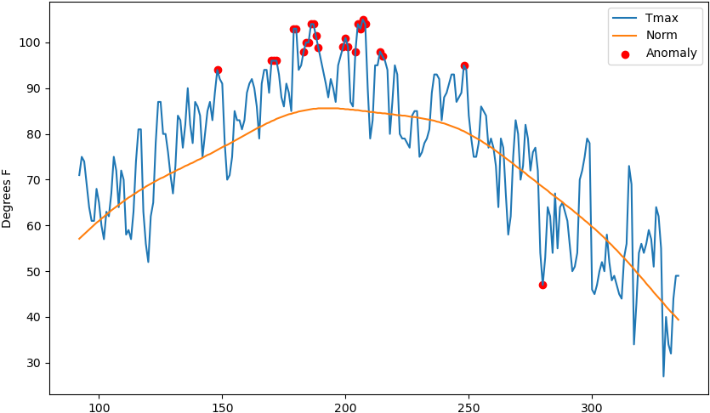
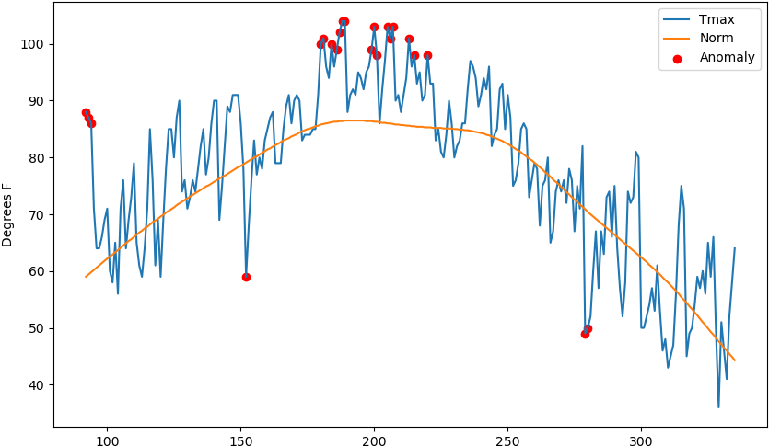
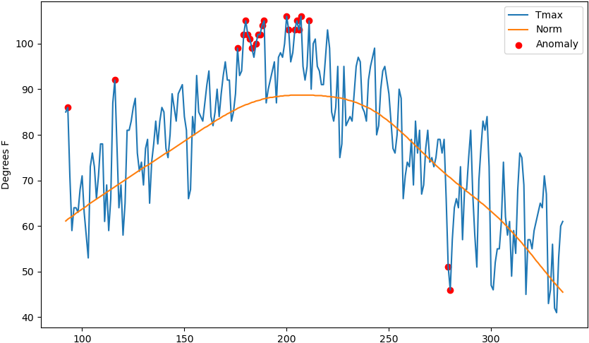
Z-score: Maximum Daily Air Temperature
Cedar Rapids, IA
Springfield, IL
Kansas City, MO

Slide 6
Z-score: Maximum Daily Air Temperature
Cedar Rapids, IA
Springfield, IL
Red dots indicate when the daily max air temperature exceeded two standard deviations from 30-year mean
Kansas City, MO

Slide 7
Z-score: Maximum Daily Air Temperature
Cedar Rapids, IA
Springfield, IL
The clustering of anomalies corresponds to the timing of the June/July 2012 record heat wave that impacted a large portion of United States
Kansas City, MO

Slide 8
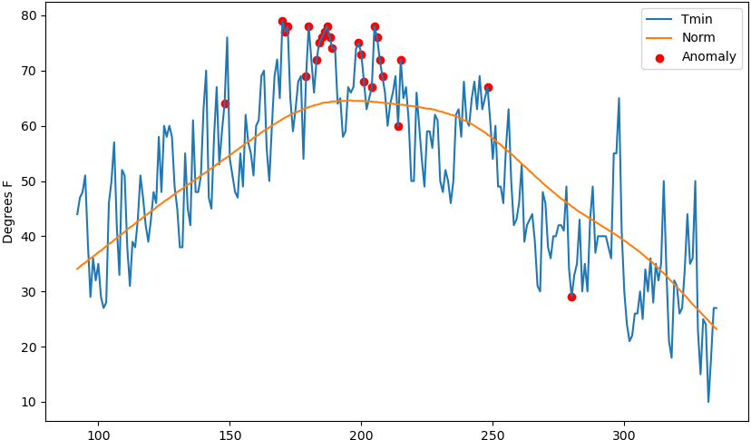
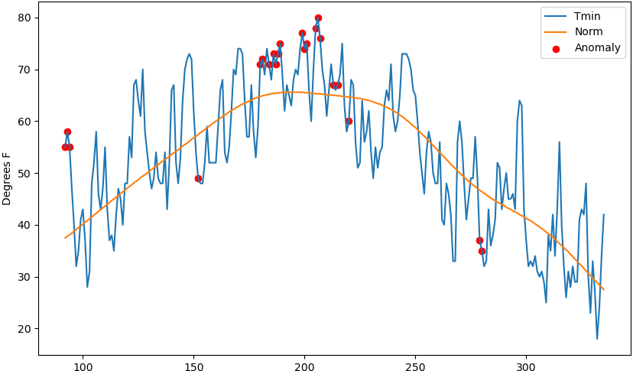
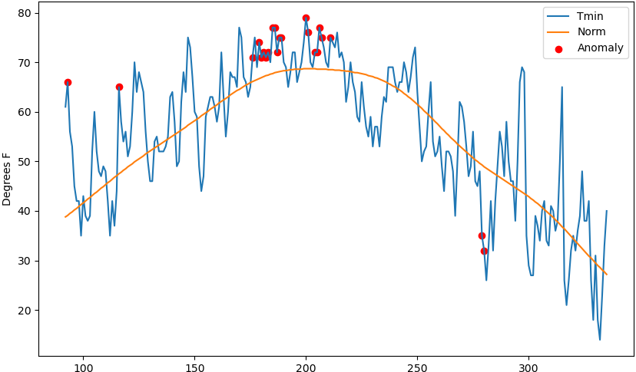
Z-score: Minimum Daily Air Temperature
Cedar Rapids, IA
Springfield, IL
Kansas City, MO

Slide 9
Z-score: Minimum Daily Air Temperature
Cedar Rapids, IA
Springfield, IL
Again, most of the anomalies align with the June/July 2012 heat wave
Kansas City, MO

Slide 10
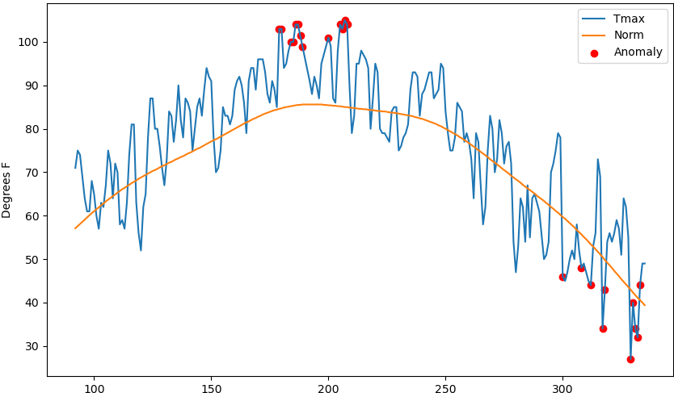
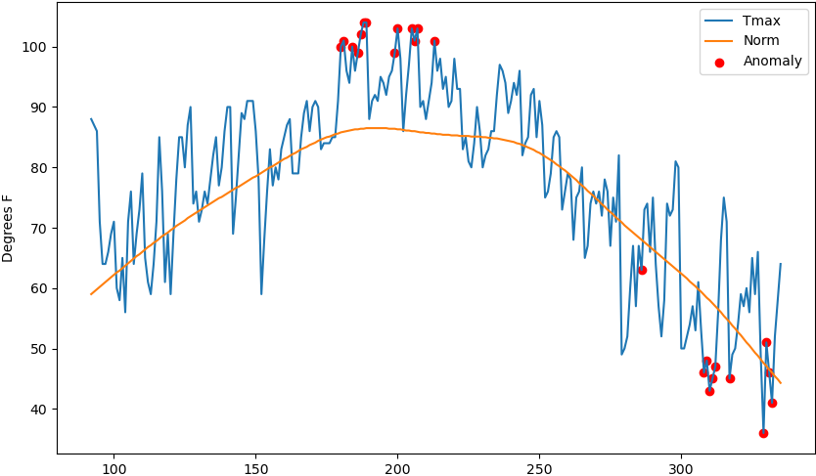
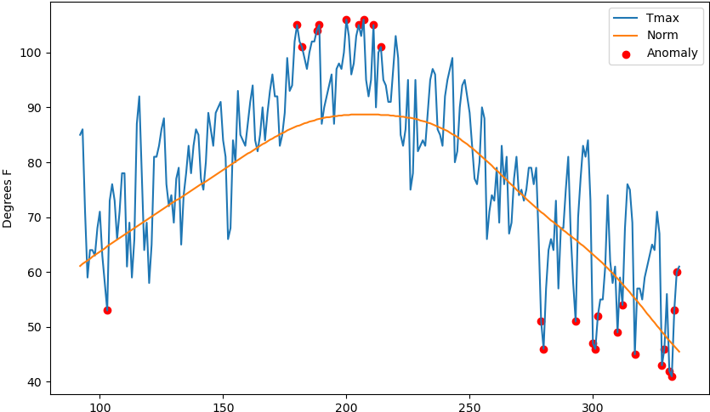
Isolation Forest: Maximum Daily Air Temperature
Cedar Rapids, IA
Springfield, IL
Kansas City, MO

Slide 11
Isolation Forest: Maximum Daily Air Temperature
Cedar Rapids, IA
Springfield, IL
Like z-score results, the identified anomalies align with the June/July 2012 heat wave
Kansas City, MO

Slide 12
Isolation Forest: Maximum Daily Air Temperature
Cedar Rapids, IA
Springfield, IL
Unlike z-score results, a second clustering of anomalies was detected in the month of November
Kansas City, MO

Slide 13
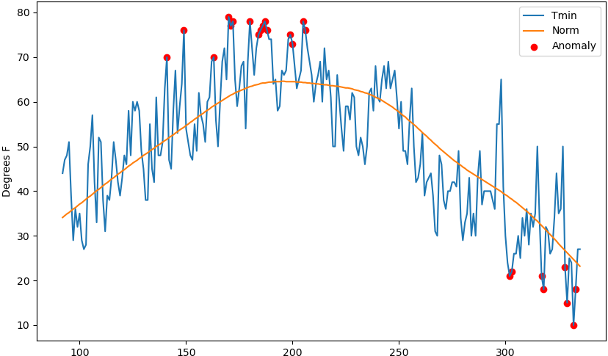
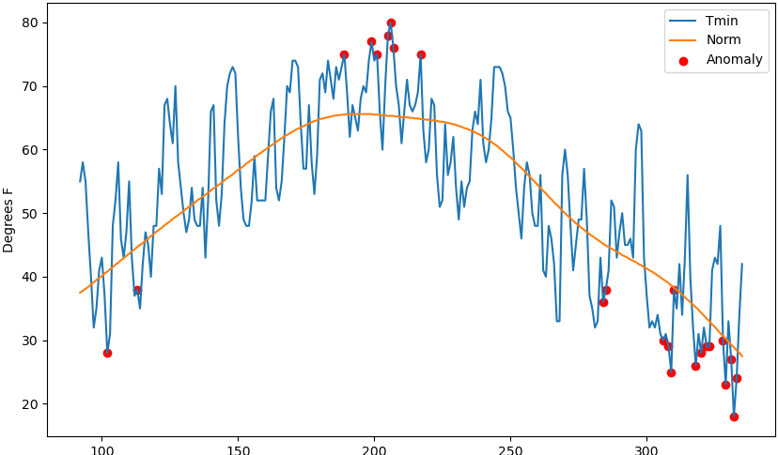
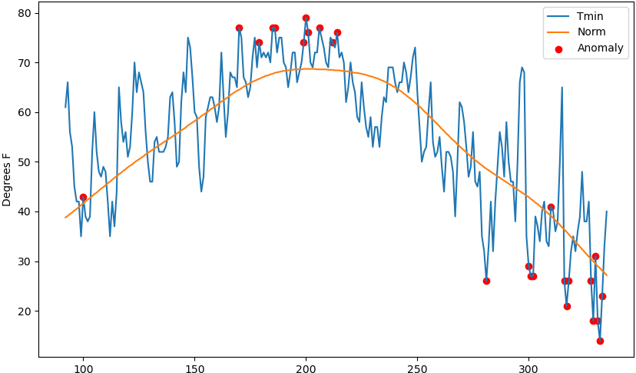
Isolation Forest: Minimum Daily Air Temperature
Cedar Rapids, IA
Springfield, IL
Kansas City, MO

Slide 14
Isolation Forest: Minimum Daily Air Temperature
Cedar Rapids, IA
Springfield, IL
Again, the detected anomalies align with the June/July 2012 heat wave
Kansas City, MO

Slide 15
Isolation Forest: Minimum Daily Air Temperature
Cedar Rapids, IA
Springfield, IL
Like for max daily air temperature, a second clustering of anomalies was detected in the month of November
Kansas City, MO

Slide 16
Conclusions
The Proof of Concept was validated by identifying the June/July 2012 record heat wave through daily max/min air temperature anomalies
The identification and quantification can be automated using anomaly detection algorithms
More work is needed to understand why the Isolation Forest method identified a second cluster of anomalies and z-score method did not (Is it physically significant?)

Slide 17
Further Research
Select a model to move forward with
Incorporate other meteorological variables (e.g., precipitation, wind speed, growing degree days, humidity, etc.)
Incorporate thresholds for identifying anomalies that physically connect to the needed growing conditions for crops

